Slide 1
RIT 1410 AI Team 4A Final Dashboard Presentation
Team Members:
ALLAM SRIDHAR
QAIS ADENIJI BELLO
RONEE HELEPI
Etc…

Slide 2
Presentation Content
Preprocessing of the Dataset
EDA
Predictive Modelling
Recommendation System

Slide 3
Preprocessing
Dataset information
Handling Missing values
Feature Engineering
Standardizing formats

Slide 4
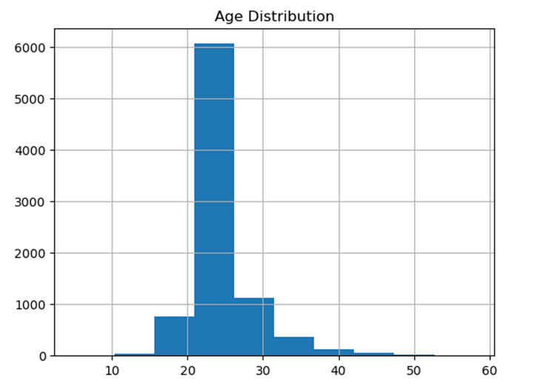
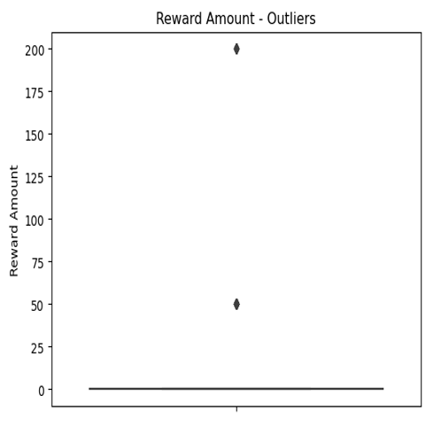
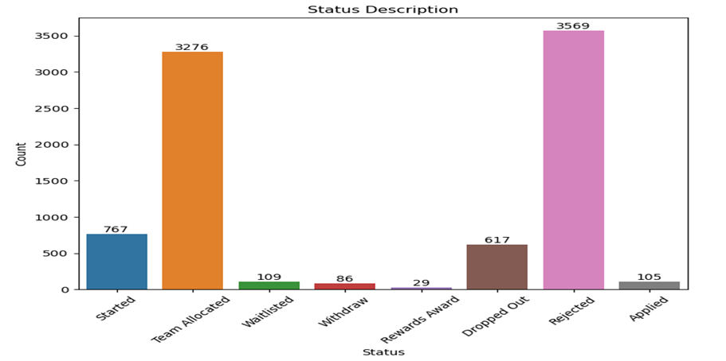
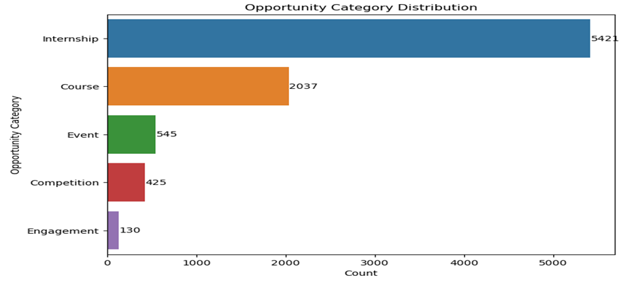
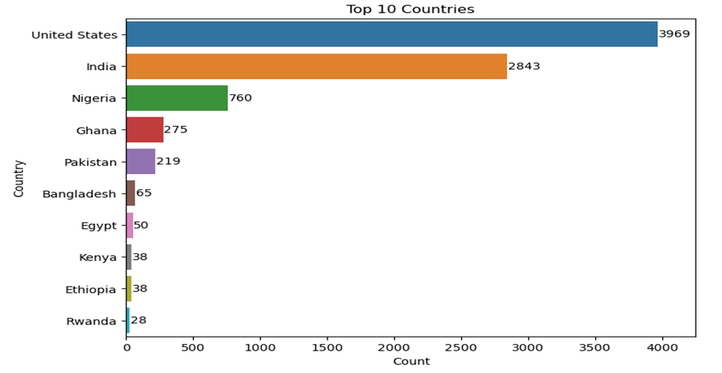
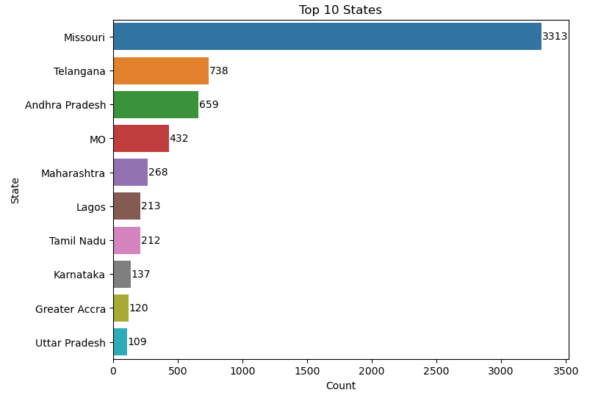
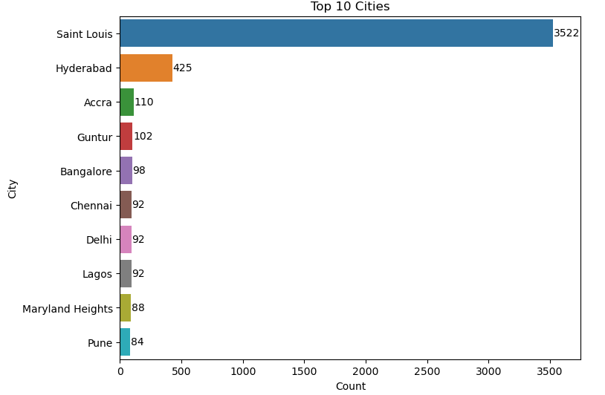
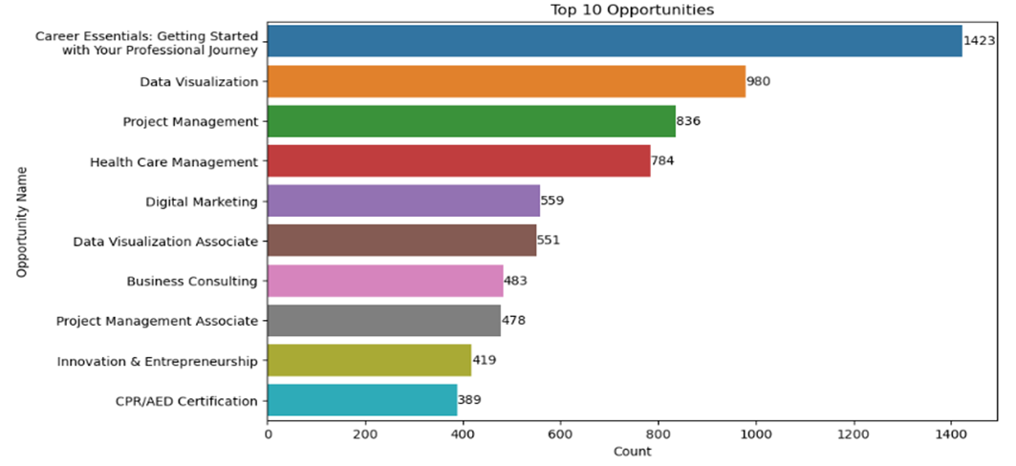
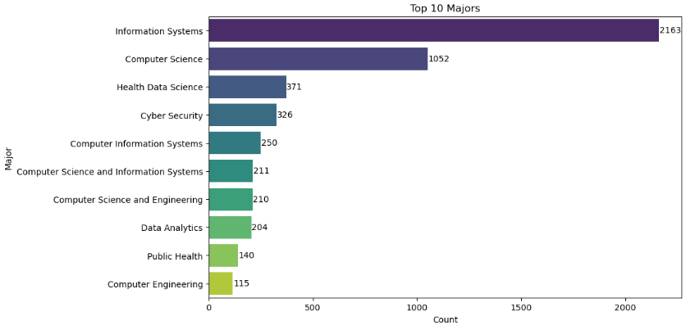
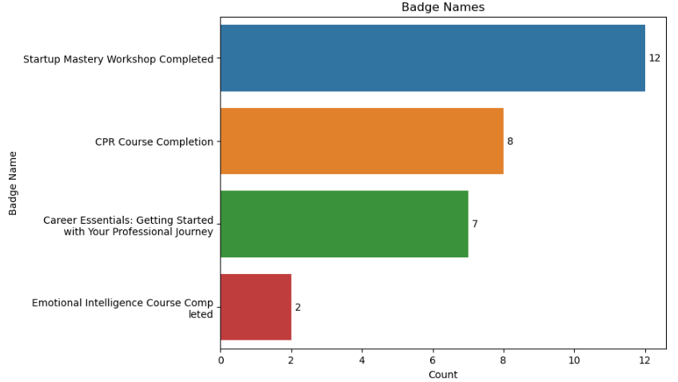
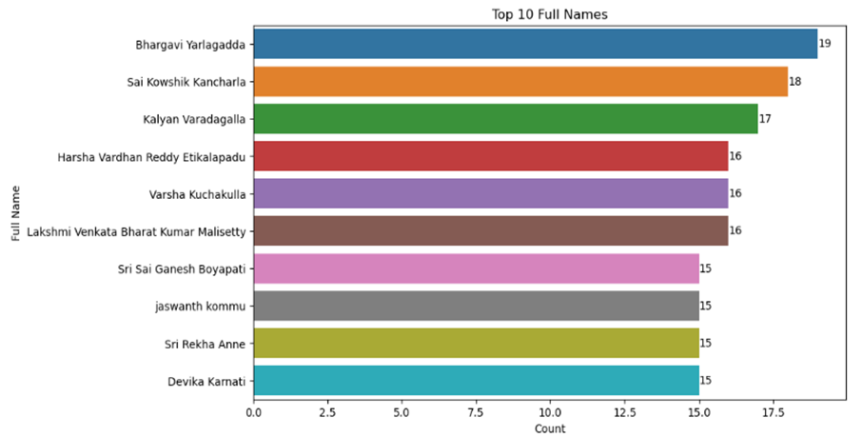
EDA (UNIVARIATE)

Slide 5
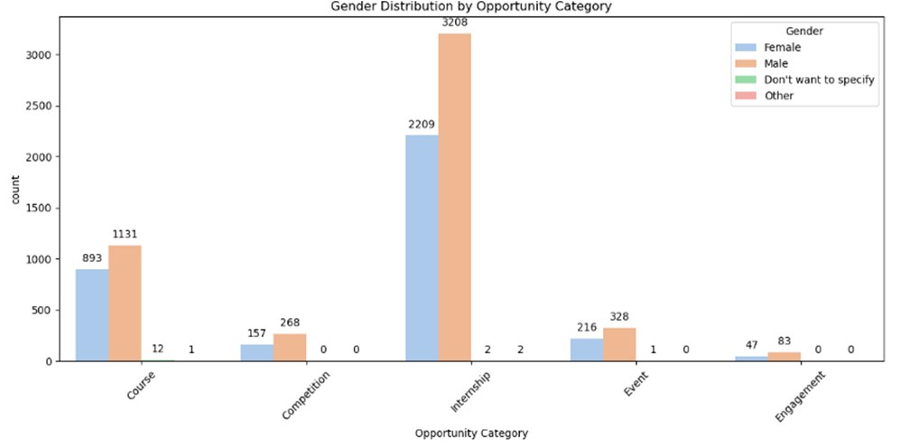
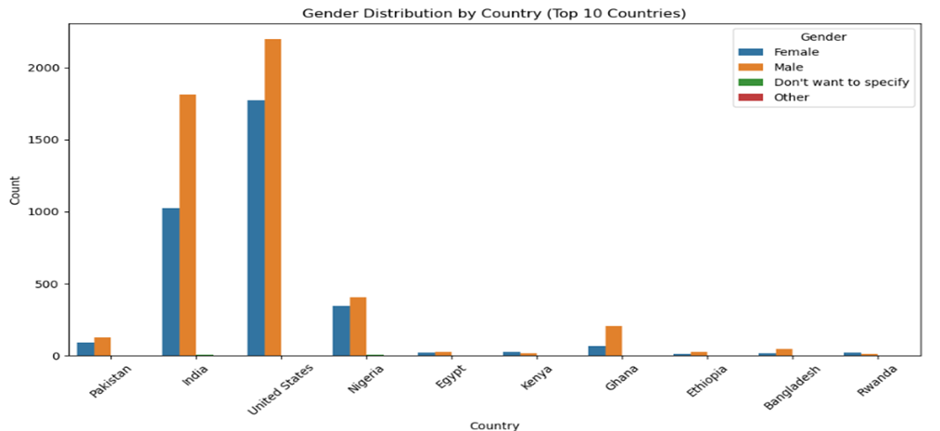
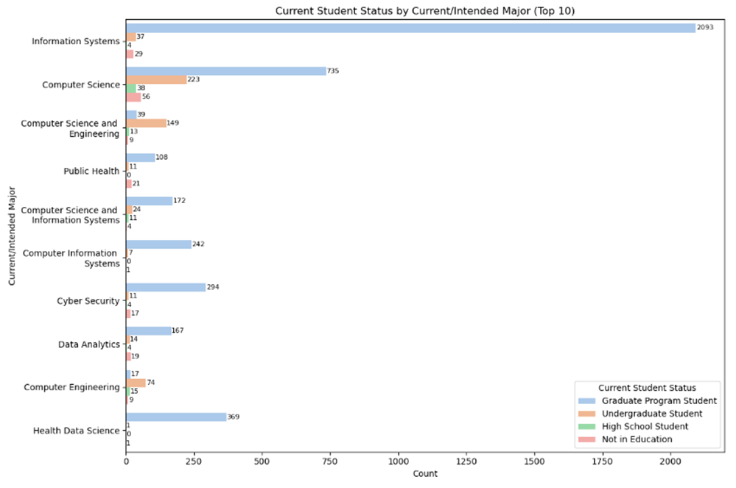
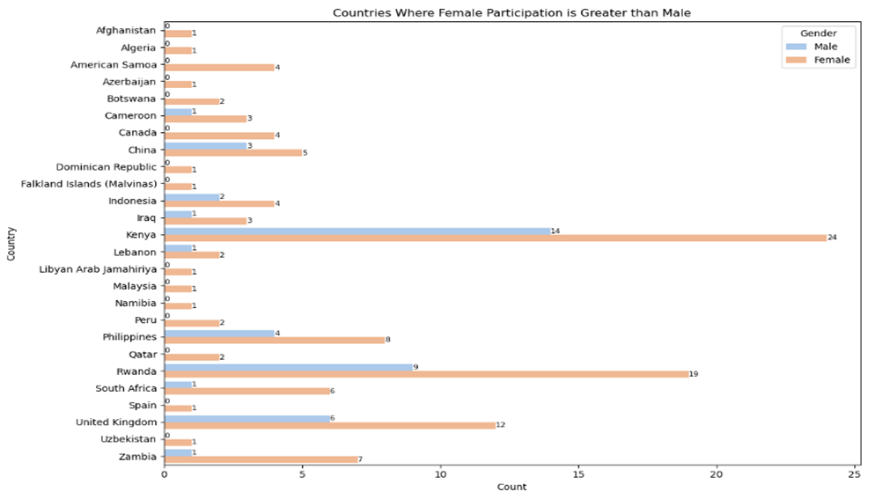
EDA (Bivariate)

Slide 6
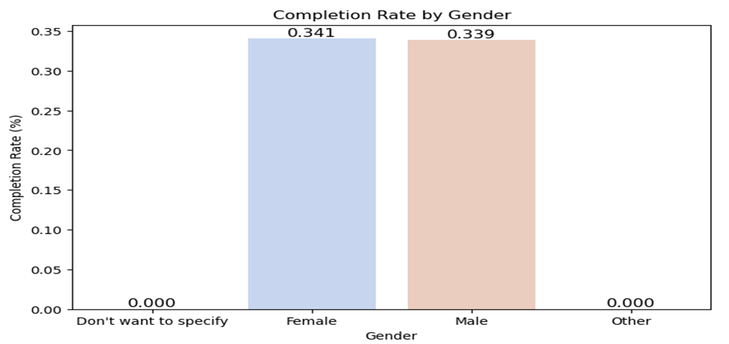
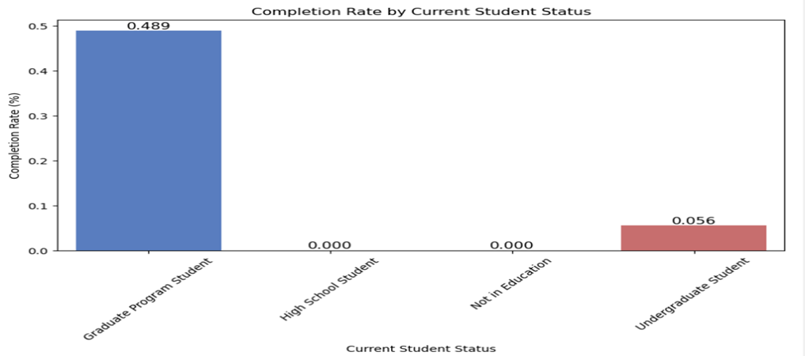
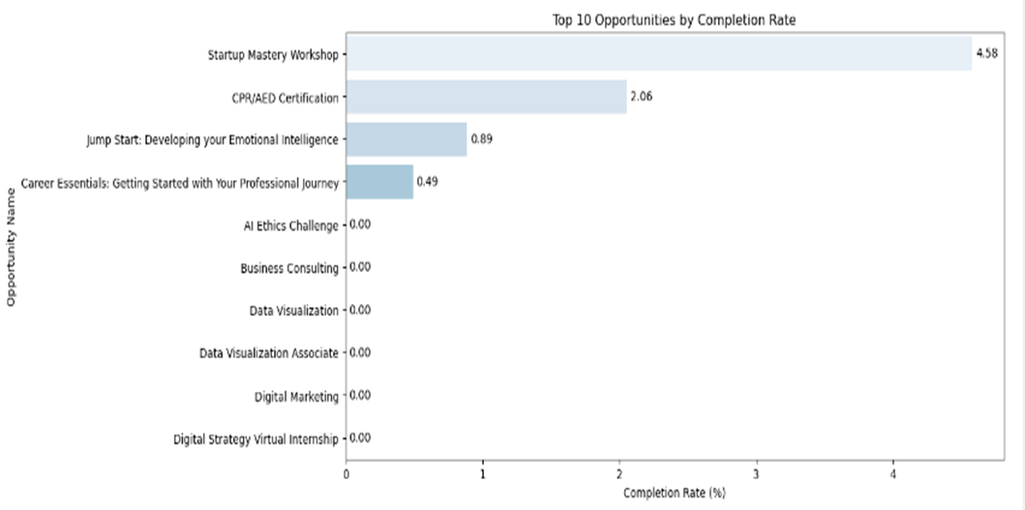
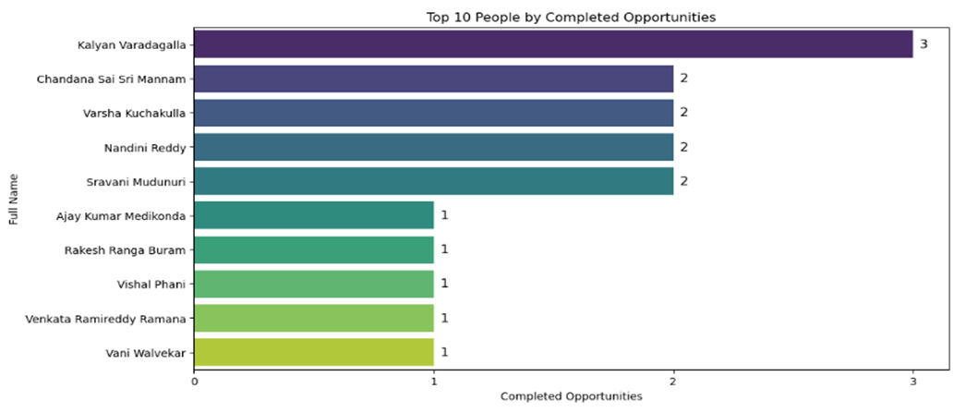
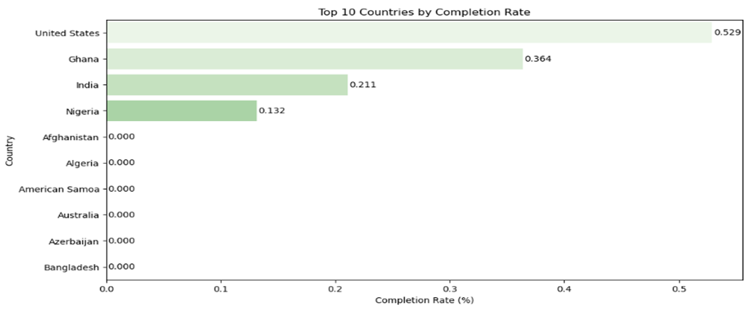
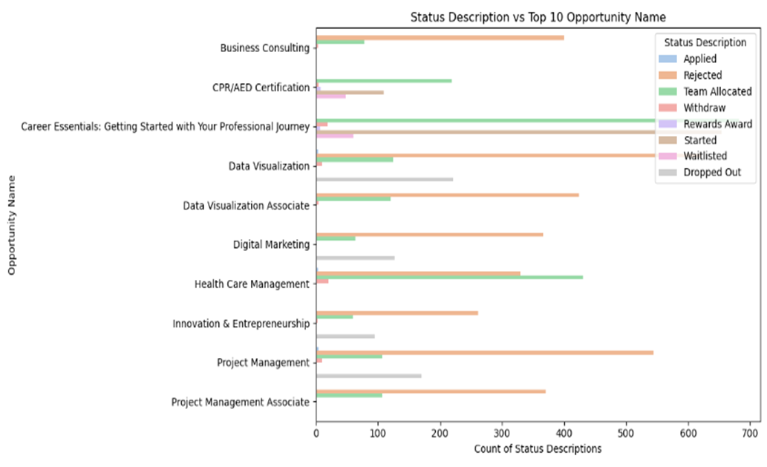
Completion Rate

Slide 7
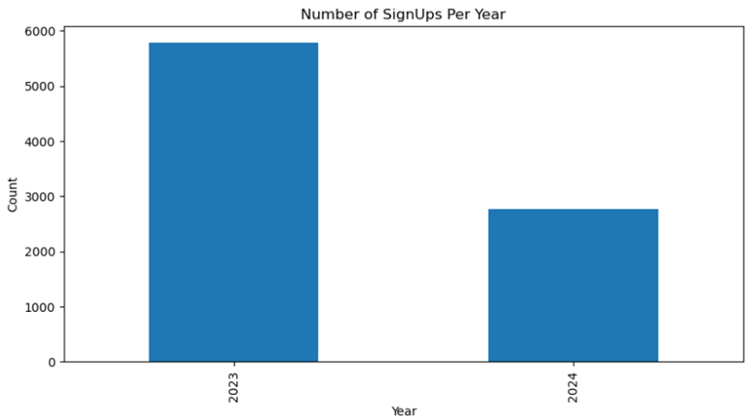
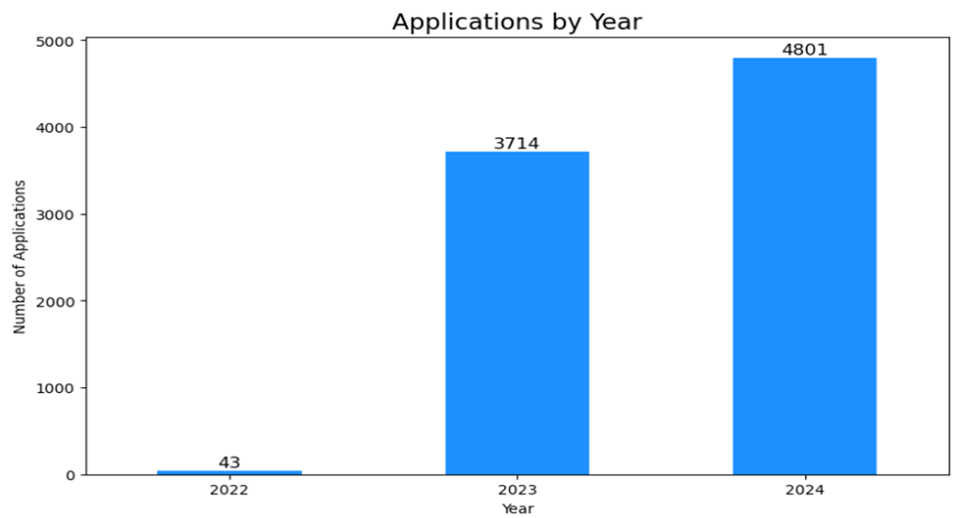
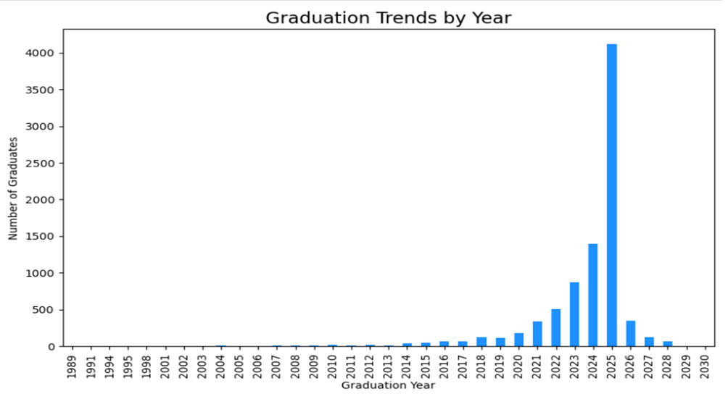
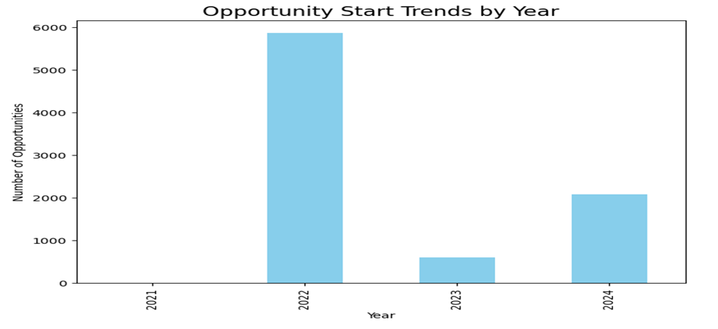
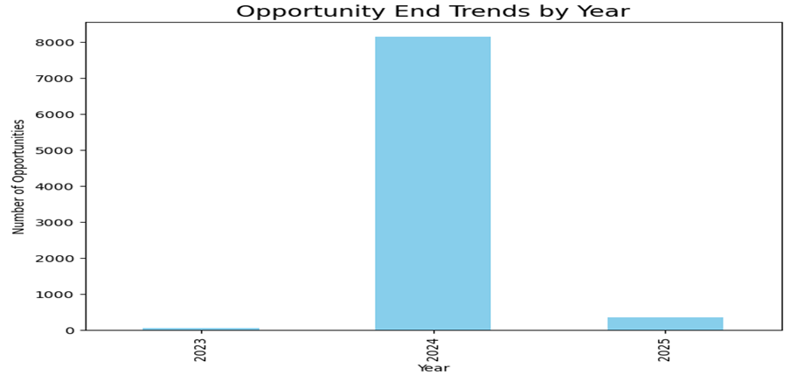
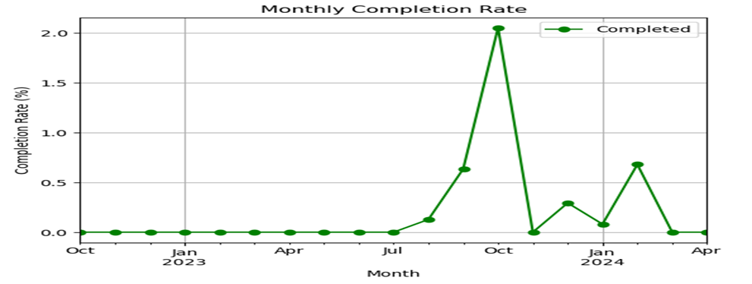
Trend Analysis

Slide 8
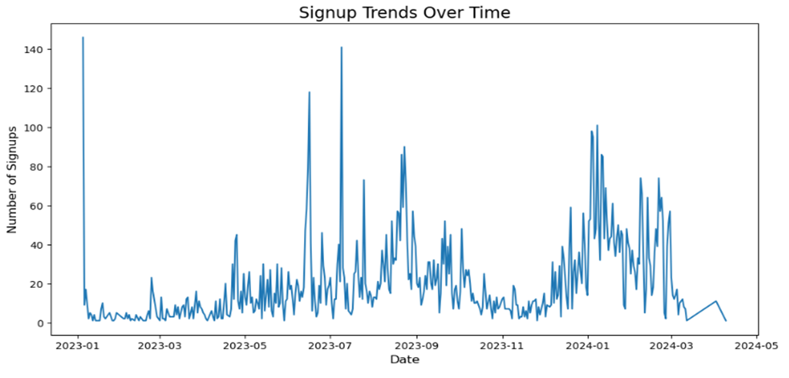
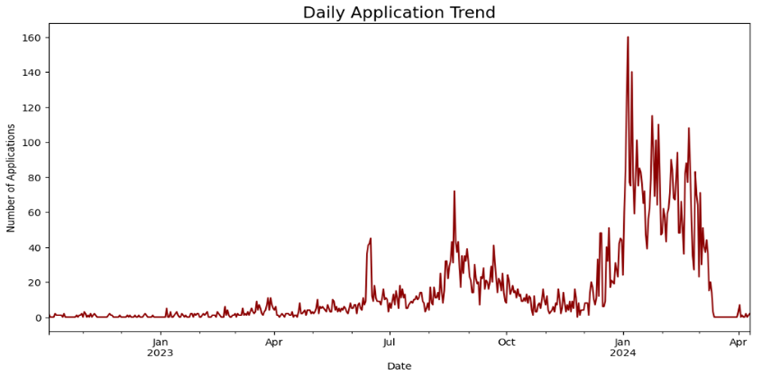
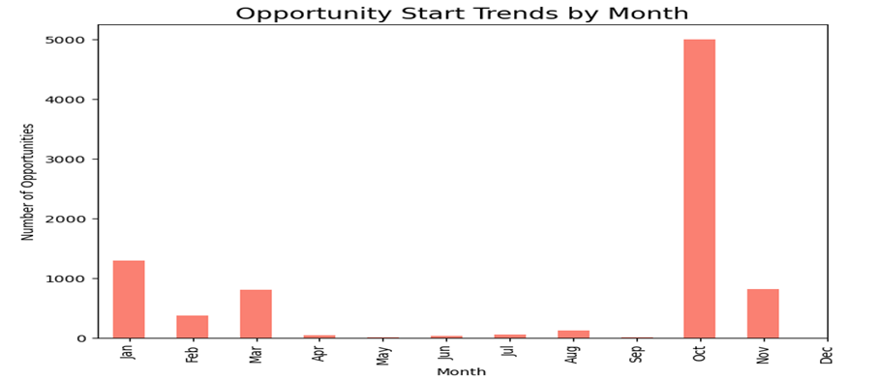
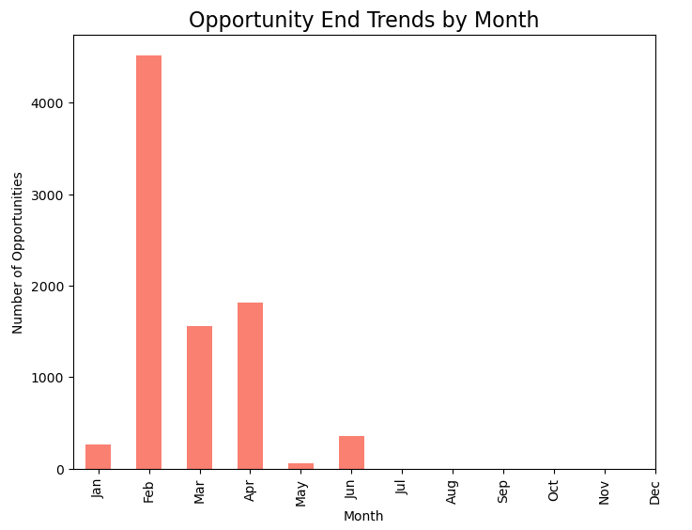
Trend Analysis

Slide 9
Churn Analysis and Predictive Modeling
Introduction
Methadology
Data Cleaning
Handling Missing Values
Converting Data Types
Feature Engineering
Churn Label Creation
Encoding Categorical Variables
Derived Features
Model Building
Logistic Regression, Decision Tree, Random Forest, Gradient Boosting, SVM, KNN, XGBoost.
Model Evaluation
Accuracy, Precision, Recall, F1-Score, AUC Curve
Feature Importance
Application Processing Time, Program Duration, Days to start,etc….

Slide 10
Model Performance
Metics | Logistic Regression | Decision Tree | Random Forest | Gradient Boosting | SVM | KNN Classifier | XGBoost
Accuracy | 79.60% | 92.01% | 95.59% | 95.33% | 89.16% | 85.59% | 95.46%
AUC curve | 0.796 | 0.920 | 0.956 | 0.953 | 0.892 | 0.856 | 0.955
Precision (class1) | 0.00 | 0.83 | 0.87 | 0.87 | 0.68 | 0.57 | 0.92
Recall (class1) | 0.00 | 0.45 | 0.41 | 0.43 | 0.36 | 0.30 | 0.40
F1- score | 0.00 | 0.58 | 0.56 | 0.57 | 0.47 | 0.39 | 0.56
conclusion | Poor Performance in identifying dropouts. Not Suitable. | Reasonable accuracy and ability to identify some droupouts, but recall is low. Can be selected with caution, further tuning may improve recall | High accuracy and good precision, but recall is still low. Can be selected. | Similar to Random Forest. Can be selected. | Lower accuracy and recall. Not suaitable. | Poor performance. Not Suitable. | High accuracy and precision, but recall is still low. Can be selected.

Slide 11
Recommendation Systems
Here we did create 3 recommendation systems:
Course recommendation System including Engagement Recommendations
Risk assessment and Recommendation System
Recommendation Systems for individual candidates, dropout probability, risk factor, dropout-factor and recommendation for that factor.

Slide 12
1. Course Recommendation System
If I pass Full Name, Age, Gender, Current/Intended Major, Current student status, status description, then it automatically calculates the similarity score from the trained data and recommend courses and also Engagement recommendations
I did pass some random test case and I got this as output:
Preparing data for recommendation system...
Data preparation completed.
Recommendations for Emmanuel Thompson:
Recommended Courses: - CPR/AED Certification
Engagement Recommendations:
Consider following up on your application status regularly
This is a longer program - consider creating a study schedule
Participate in online discussion forums
Set up regular check-ins with mentors - Join study groups or form one Preparing data for recommendation system...
Data preparation completed. All test cases passed successfully!

Slide 13
2. Risk assessment Recommendation System
If I pass Full Name, Age, Gender, Current/Intended Major, Current student status, status description, then it automatically calculates the similarity score from the trained data and gives personalized opportunities, Risk level, Risk assessment and recommendations.
Testing Recommendation System...
Recommendations for student: Faria Khan
Personalized Recommendations:
Opportunity Name Score
Jump Start: Developing your Emotional Intelligence 0.475757
CPR/AED Certification 0.410727
AI Ethics Challenge 0.299546
Innovation & Entrepreneurship 0.299546
Health Care Management 0.299546
Risk Assessment and Recommendations: Risk Level: Low
Risk Suggested Actions:
Continue current engagement level
Consider mentoring other students
Explore advanced opportunities
- Share success strategies with peers

Slide 14
Recommendation Systems for individual candidates, dropout probability, risk factor, dropout-factor and recommendation for that factor.
Preparing data for dropout risk assessment...
Data preparation completed.
Training dropout prediction model...
Top 5 Risk Factors: feature importance
application_processing_time 0.271550
program_duration 0.183885
days_to_start 0.121904
days_to_end 0.113052
Opportunity Category_encoded 0.089253
Recommendations for Rachel Grant
Student_name: Rachel Grant
Risk_profile: {'dropout_probability': 0.6777507472686044, 'risk_level': 'High’}
Risk_factors:
{'factor': 'Long application processing time', 'recommendation': 'Follow up on your application status and ensure all required documents are submitted’}
{'factor': 'Long program duration', 'recommendation': 'Create a detailed study schedule and set regular milestones’},
{'factor': 'Late program start', 'recommendation': 'Contact program coordinator for catch-up materials and extra support'}, {'factor': 'Technical program complexity', 'recommendation': 'Join study groups and utilize online learning resources’}.
Recommended_Interventions: Schedule immediate academic counseling session, Assign a peer mentor, Provide access to additional learning resources, Set up weekly progress monitoring.

